Slide 1
INFORMATIONAL SYSTEM FOR BUSINESS AUTOMATION
Yaroslav Holota

Slide 2
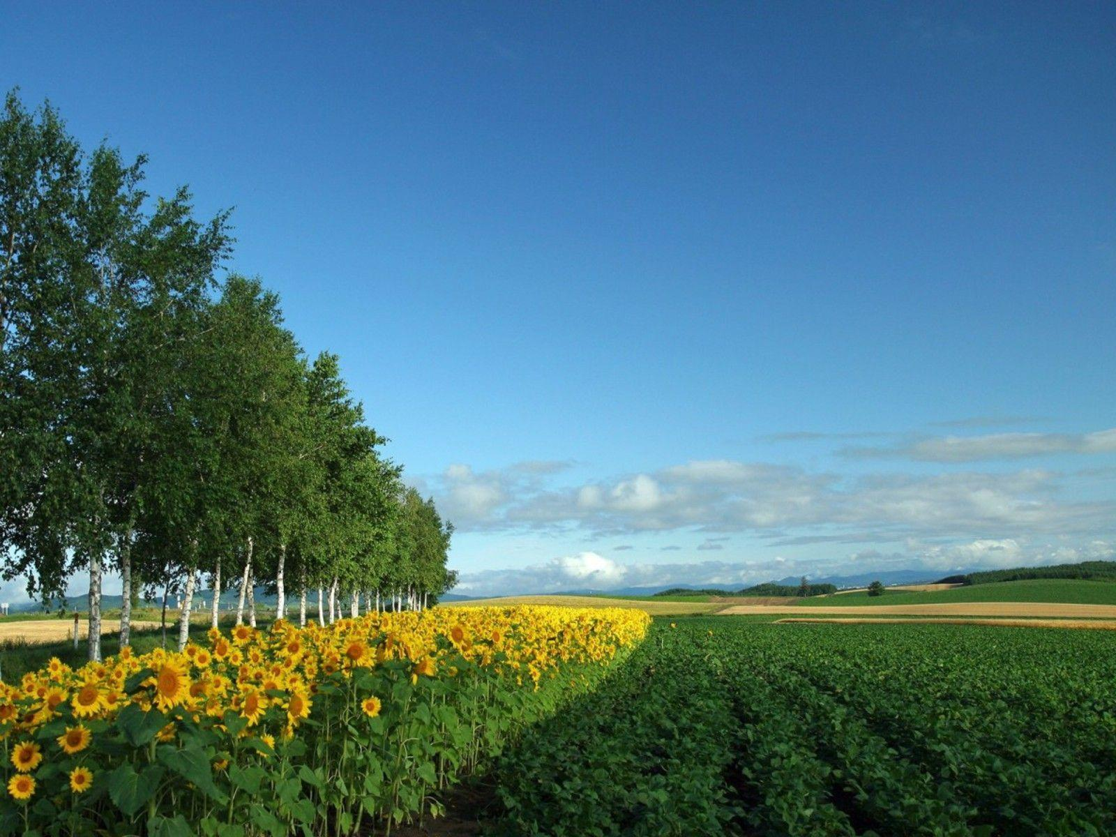
Agenda:
Introduction
Primary User Tasks
Architecture
Yaroslav Holota (yaroslavholota@gmail.com)

Slide 3

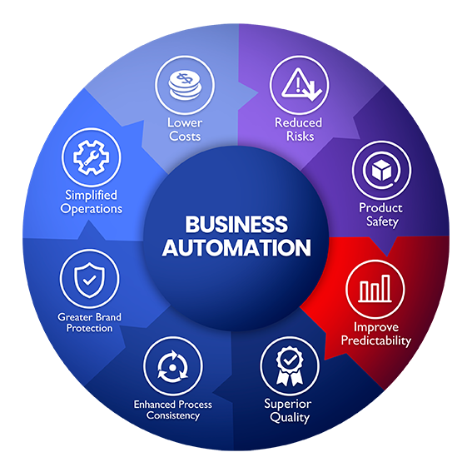
Automation of business processes results in increase in their productivity, as such performing this operation in an efficient and predictable fashion is crucial. That is the goal of the work.
Yaroslav Holota (yaroslavholota@gmail.com)

Slide 4

Consumer
Find plants
Order plants
Watch instructions
Producer
Care for plants
Sell plants
Deliver plants
Create instructions
Manager
Data analysis
User Management
Yaroslav Holota (yaroslavholota@gmail.com)

Slide 5
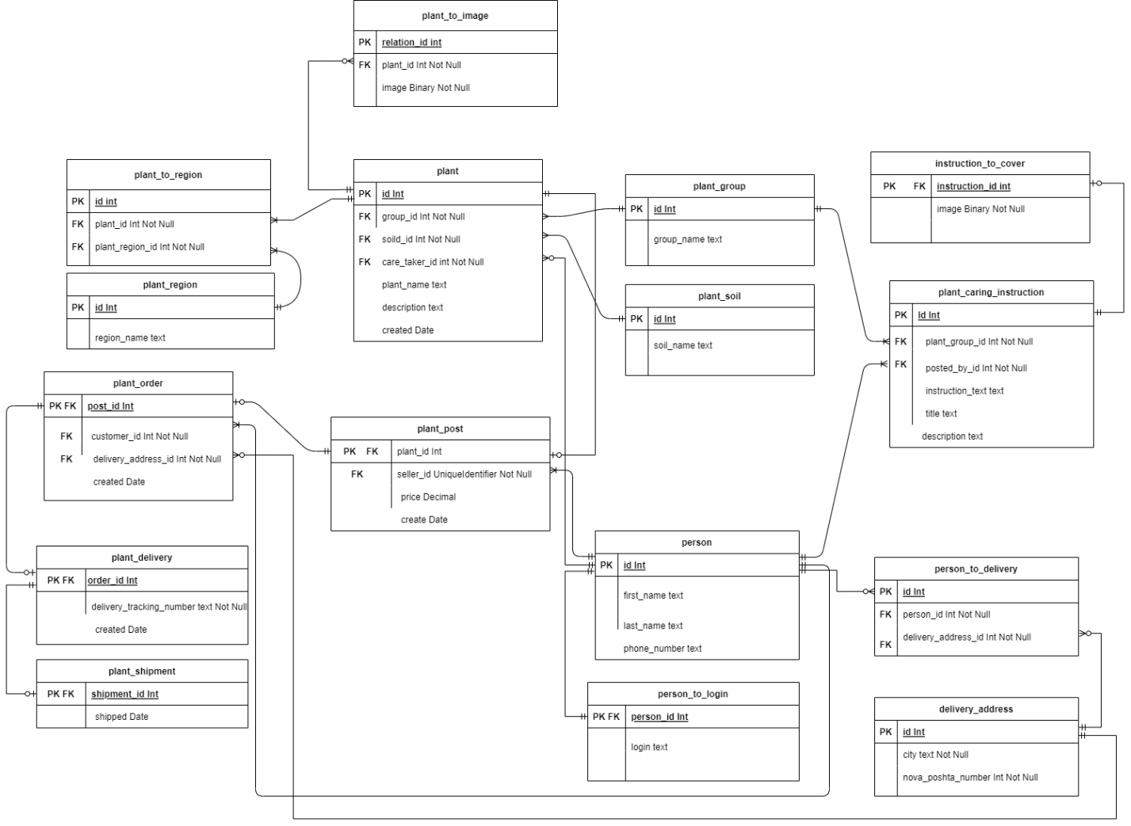

Slide 6
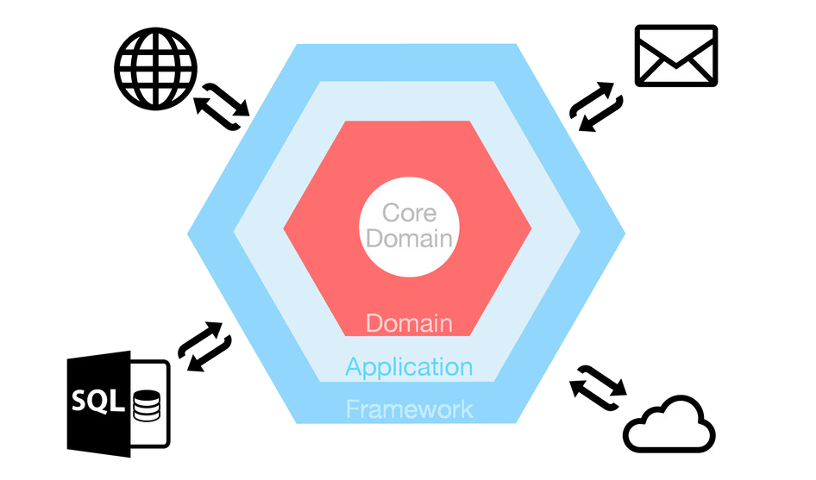
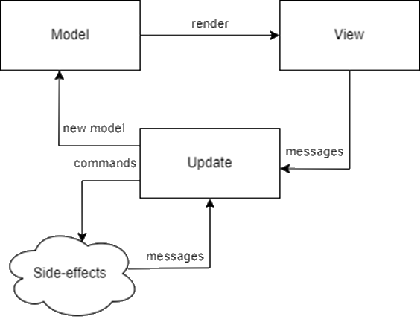
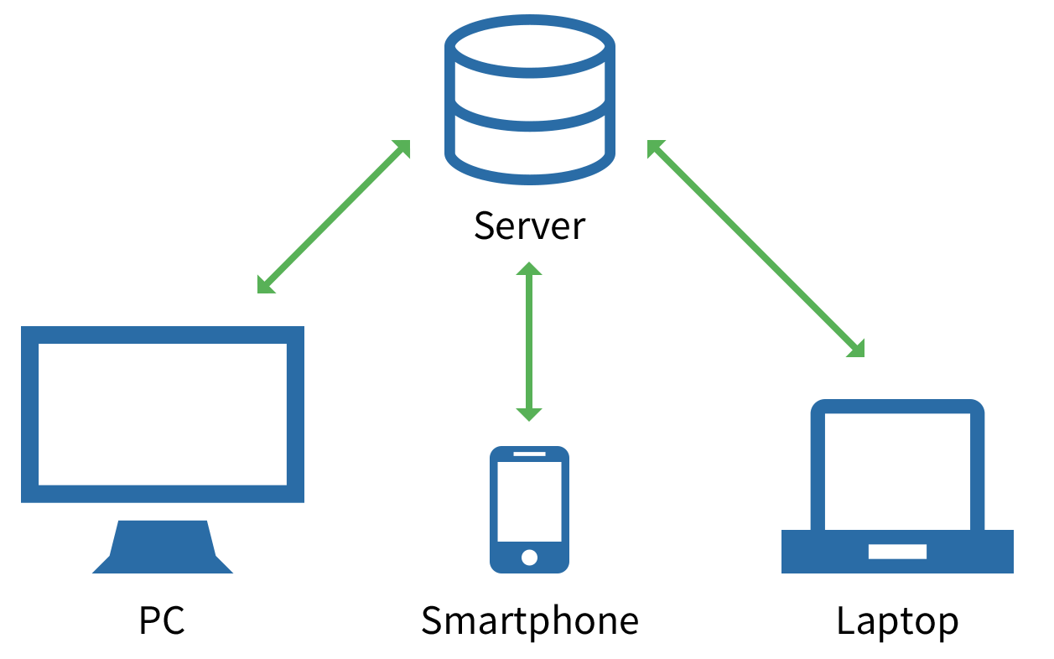
“Architecture: The Stuff That's Hard to Change”
Software products call for flexible, yet unambiguous architecture to obtain support for continuous updates.
Yaroslav Holota (yaroslavholota@gmail.com)

